Slide 1
Week 11 Supervisor Meeting
Software Engineering
G2T2

Slide 2
Content
Project Progress (Previous Iterations)
Project Requirement Changes (OH NO!)
Actions Taken
Iteration 5 Updates

Slide 3
Project Progression
Iteration 1 - 4

Slide 4
Iteration 1 – 3 (Recap)
Iteration 1
(PM Claudie Ang)
Iteration 2
(PM Claudie Ang)
Project Planning
Assign Roles
System Design
Prepare SD, Use Case Diagram
System Design
Develop Login Function

Slide 5
Iteration 1 – 3 (Recap)
Iteration 3 (PM Tian De Wang)
Test and Debugging for Login function
Develop Bootstrap / Update Additional Data Functions
Develop Basic App Usage Reports Functions
Integrate and Local Testing and Debugging

Slide 6
Iteration 1-3 (Recap)
ISSUES:
Git Repository (App within an App folder)
Wrong Naming of Files on Git
(bm.xlsx, ppm.xlsx)
Work Allocation Is Skewed
OpenShift URL Wrong
Login User Name (Email ID instead of Name)

Slide 7
Iteration 1-3 (Recap)
Actions Taken:
Fixed GIT Repository
Changed Naming of Files
Allocate Claudie minimum work for Iteration 4, while the rest catch up.
Fixed OpenShift URL
Update Login Using Email ID

Slide 8
Iteration 4 Review
PM (Gao Shuang)
Delayed Tasks from Iteration 3
OpenShift Deployment
Testing and Debugging on OpenShift
Develop Top K Usage Report
Develop Smartphone Over-use Report
Integration, local Testing and Debugging
OpenShift Deployment
Testing and Debugging on OpenShift

Slide 9
Iteration 4 Review
Task Metric
Iteration | Plan | Actual | Score | Action
1 | 4 | 4 | 1 | No actions required
2 | 17 | 17 | 1 | No actions required
3 | 21 | 16 | 0.77 | Re-estimate the tasks for the future iterations. Deduct the number of days behind schedule from buffer days. If there is no more buffer day, decide the functionalities to drop.
4 | 23 | 23 | 1 | No actions required

Slide 10
Iteration 4 Review
BUG Metrics
41 Points > 10 Stop current development and resolve the bug immediately.
Formula: 1 x 16 (low) + 5 x 1 (high) + 10 x 2 (critical)
Points in Iteration | Action
Points < 10 | Use the planned debugging time in the iteration.
Points >= 10 | Stop current development and resolve the bug immediately. Project Manager reschedules the project.

Slide 11
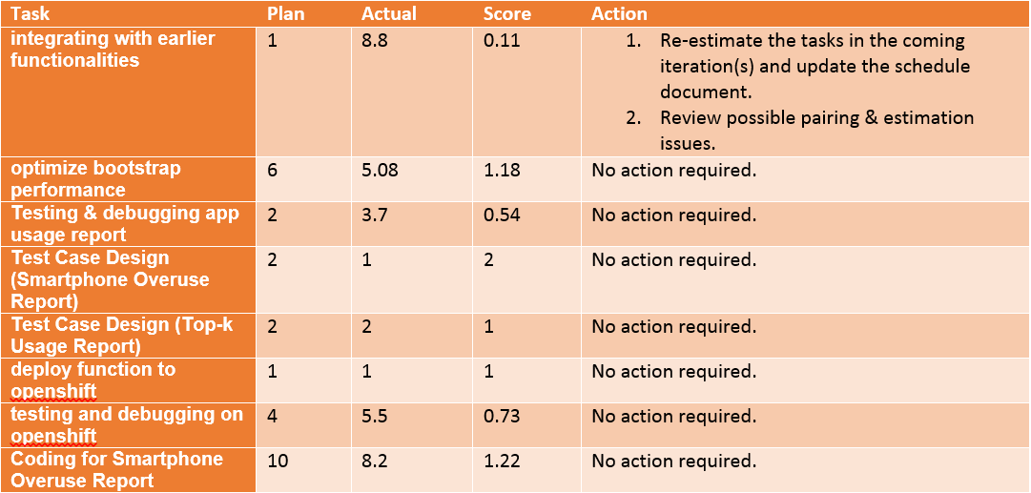
Iteration 4 Review
Pair Programming Metric

Slide 12
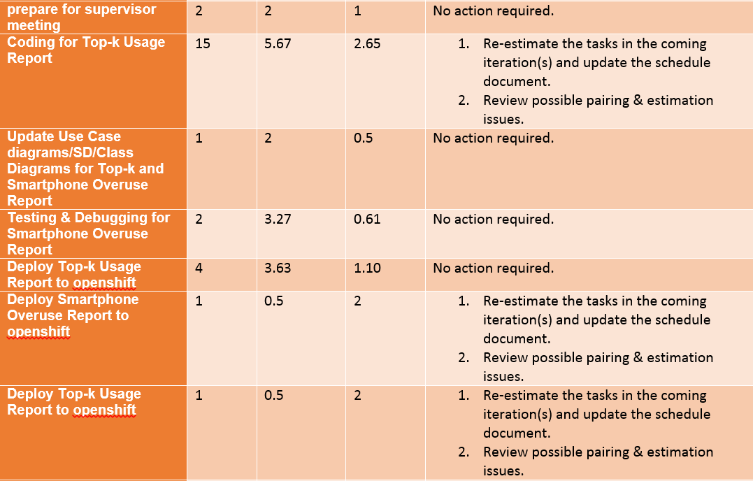
Iteration 4 Review

Slide 13
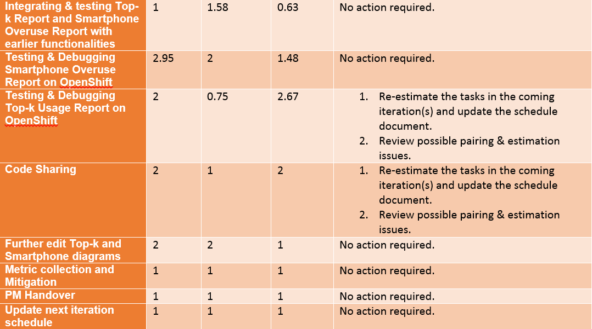
Iteration 4 Review

Slide 14
Project Requirement Changes
Iteration 5

Slide 15
Project Requirement Changes
Iteration 5
Demographics.csv adding CCA records
Bootstrap / Upload Additional Data Handling Columns
Basic App Usage Report
(Break down by usage time category and demographics)
Performance (2 mins 30 s for data v2)

Slide 16
Project Requirement Changes
Actions Taken
Internal Meeting 23rd OCT 2015
Gather Input on Requirement Changes
Re-estimate Time to Complete the Changes
Re-schedule Iteration 5

Slide 17
Project Requirement Changes
Iteraion 5 Overview
23-10-2015
Internal Meeting
Update Diagrams
Update Test Cases
24-10-2015 to 25-10-2015
Develop Bootstrap Changes
Develop Basic App Usage Report Changes
26-10-2015
Integration and Testing (Local)
Deploy and Testing (OpenShift)

Slide 18
Project Requirement Changes
Iteraion 5 Overview
27-10-2015 to 30-10-2015
Develop Dual UI (Web and JSON)
30-10-2015
Integrate and Local Testing (Dual UI)
31-10-2015
Deployment and Testing on OpenShift
01-11-2015 to 03-11-2015
Buffer Time (3 days) Reduced (from 7 days previously)
04-11-2015 (11pm)
Final Deployment for UAT
UAT (07-11-2015, SAT, 2pm-3:30pm. SIS SR 3-2)

Slide 19
THE END
THANK YOU!

